Slide 1
Draping
Lesson 3 – Advanced Techniques

Slide 2
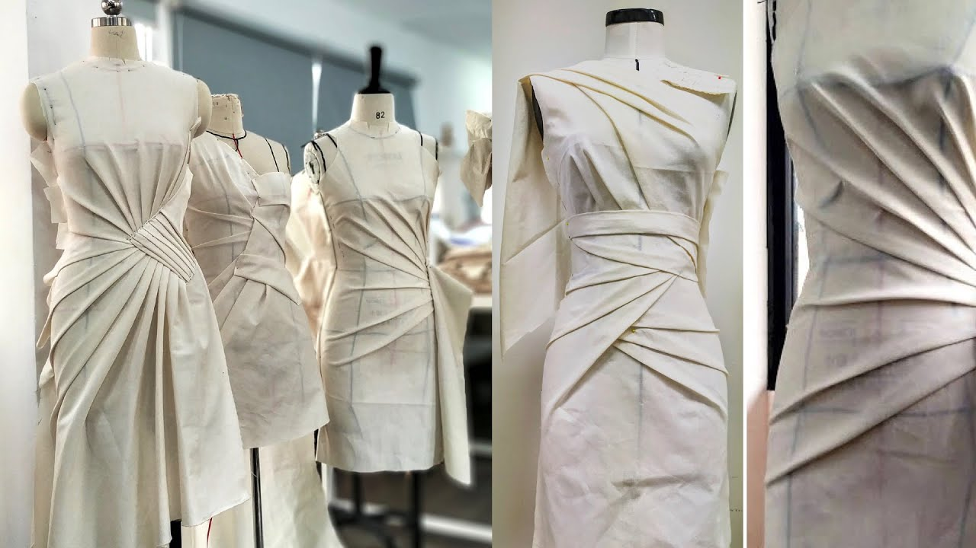
Pleats
Pleats are folds in the fabric, often seen in skirts
it can also be used for bodices like this ---------→
Pleats are the easiest of these advanced techniques to master as its just folding over the fabric

Slide 3

Ruching
Ruching is when the fabric is bunched up to look like this →
Ruching can be hard to achieve in draping, and requires
good pin work

Slide 4
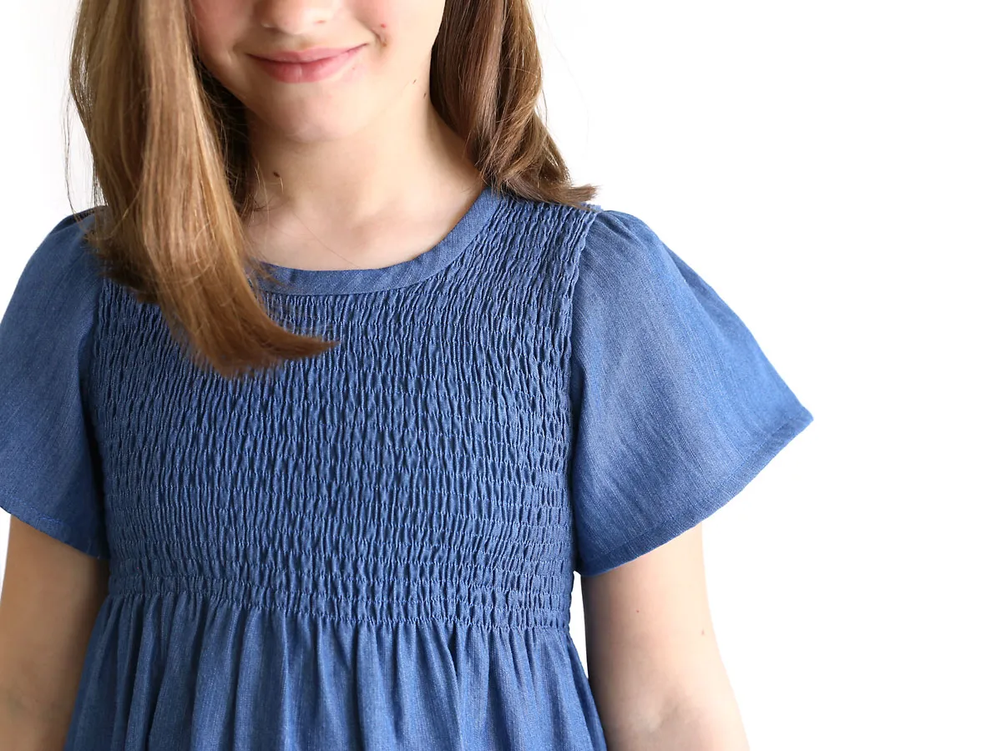
Shirring
See the bumpy texture in the bodice of this dress →
That’s shirring. It’s done with gathering stitches and elastic to create a stretchy garment

Slide 5
Adding Boning
Boning is most often found in corsets, but can also be found in the bodice of a full dress.
Boning is often made with steel and makes for a more structured garment

Slide 6
Video
https://www.youtube.com/watch?v=fB6KAPlZqTo

Slide 7
Practice: Assignment 4-3
Make 4 dresses
1 for each technique
See Assignment 4-3 paper for more details

